Slide 1
#myDHis
international
inclusive
collaborative
student-focused
interdisciplinary
enabling new research questions
@Laura_Estill

Slide 2

Notes:
WSB : international, languages, students

Slide 3
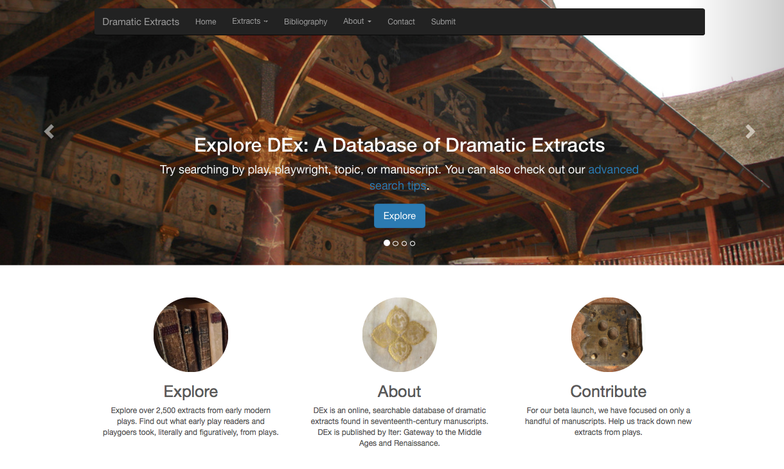
dex.citd.tamu.edu
Notes:
Student workers; new research questions; from book history

Slide 4
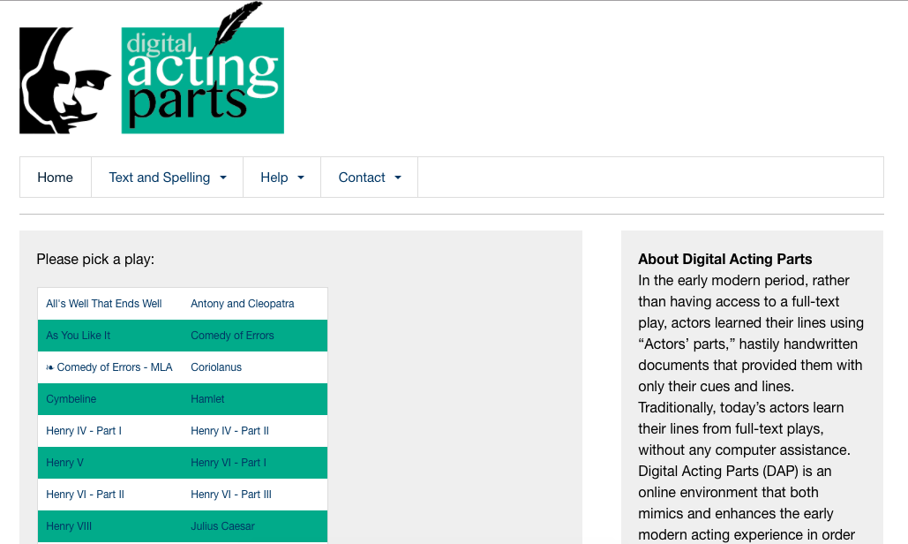
digitalactingparts.tamu.edu
Notes:
Interdisciplinary team; collaboration

Slide 5
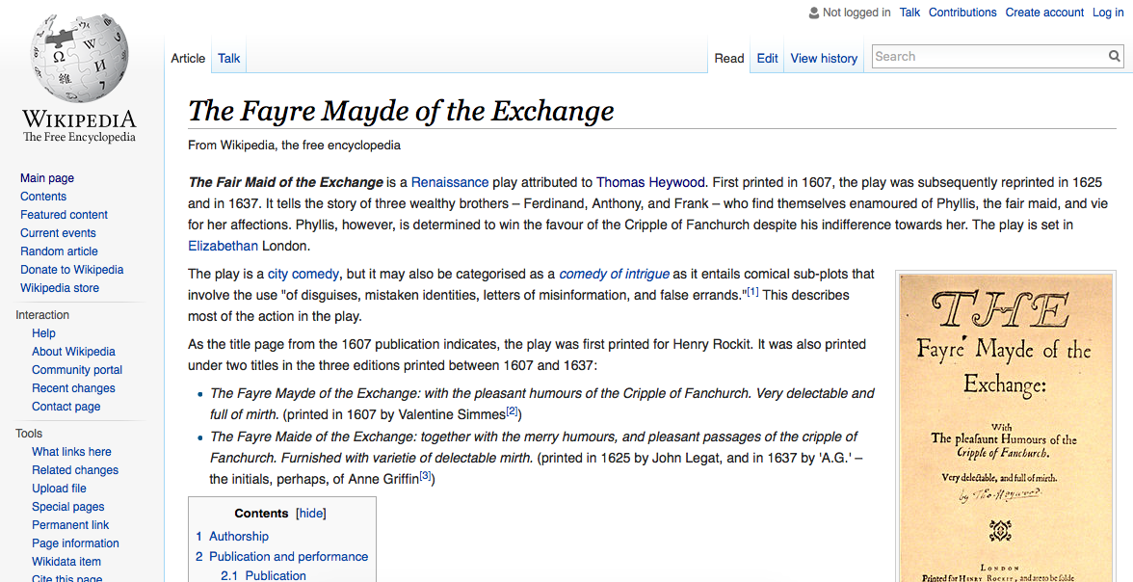
Notes:
Students undertaking primary research

Slide 6
#myDHis
international
inclusive
collaborative
student-focused
interdisciplinary
enabling new research questions
@Laura_Estill

